Slide 1
Chapter-4
Data Link Layer & Medium Access Sub layer

Slide 2
Error Detection and Correction
Types of Errors
Detection
Correction

Slide 3
Basic concepts
Networks must be able to transfer data from one device to another with complete accuracy.
Data can be corrupted during transmission.
For reliable communication, errors must be detected and corrected.
Error detection and correction are implemented either at the data link layer or the transport layer of the OSI model.

Slide 4
Single-bit error

Slide 5
Single bit errors are the least likely type of errors in serial data transmission because the noise must have a very short duration which is very rare. However this kind of errors can happen in parallel transmission.
Example:
If data is sent at 1Mbps then each bit lasts only 1/1,000,000 sec. or 1 μs.
For a single-bit error to occur, the noise must have a duration of only 1 μs, which is very rare.

Slide 6
Burst error

Slide 8
The term burst error means that two or more bits in the data unit have changed from 1 to 0 or from 0 to 1.
Burst errors does not necessarily mean that the errors occur in consecutive bits, the length of the burst is measured from the first corrupted bit to the last corrupted bit. Some bits in between may not have been corrupted.

Slide 9
Burst error is most likely to happen in serial transmission since the duration of noise is normally longer than the duration of a bit.
The number of bits affected depends on the data rate and duration of noise.
Example:
If data is sent at rate = 1Kbps then a noise of 1/100 sec can affect 10 bits.(1/100*1000)
If same data is sent at rate = 1Mbps then a noise of 1/100 sec can affect 10,000 bits.(1/100*10⁶)

Slide 10
Error detection
Error detection means to decide whether the received data is correct or not without having a copy of the original message.
Error detection uses the concept of redundancy, which means adding extra bits for detecting errors at the destination.
Notes:
Make sense of message.
Make sense of message.

Slide 11
Redundancy

Slide 12
Error detection techniques:
Popular techniques are:
1.Simple Parity check
2.Two-dimensional Parity check
3.Checksum
4.Cyclic redundancy check

Slide 13
(1) Parity Checking:
Simple or Two Dimensional
In parity check, a parity bit is added to every data unit so that the total number of 1s is even or odd.

Slide 14
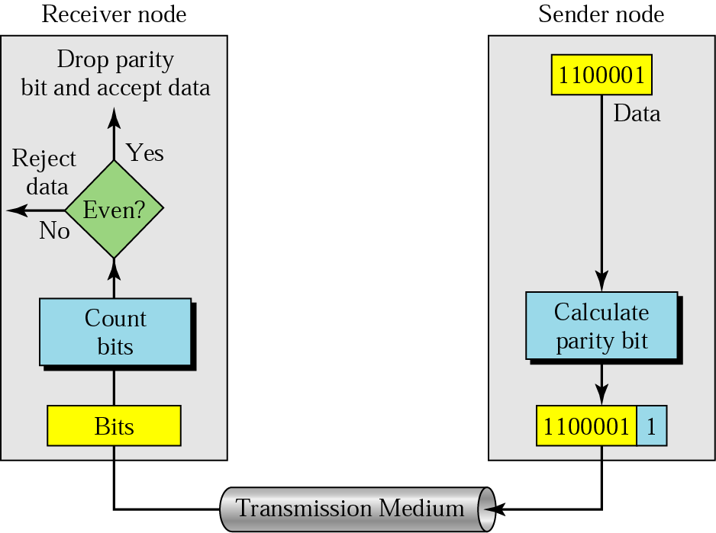
(1) Parity Checking:

Slide 15
(1) Parity Checking:
Suppose the sender wants to send the word world. In ASCII the five characters are coded as
1110111 1101111 1110010 1101100 1100100
The following shows the actual bits sent
11101110 11011110 11100100 11011000 11001001

Slide 16
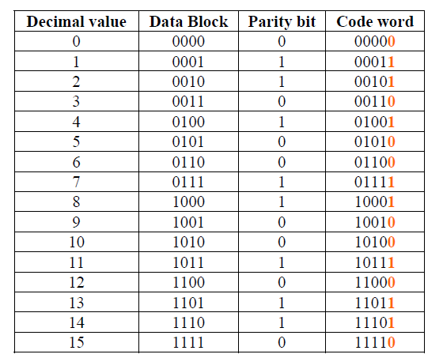
Possible 4-bit data words and corresponding code words

Slide 17
(1) Parity Checking:
Two-dimensional parity
In two-dimensional parity check, a block of bits is divided into rows and a redundant row of bits is added to the whole block.
Performance can be improved by using two-dimensional parity check, which organizes the block of bits in the form of a table.
Parity check bits are calculated for each row, which is equivalent to a simple parity check bit.
Parity check bits are also calculated for all columns then both are sent along with the data.
At the receiving end these are compared with the parity bits calculated on the received data

Slide 18
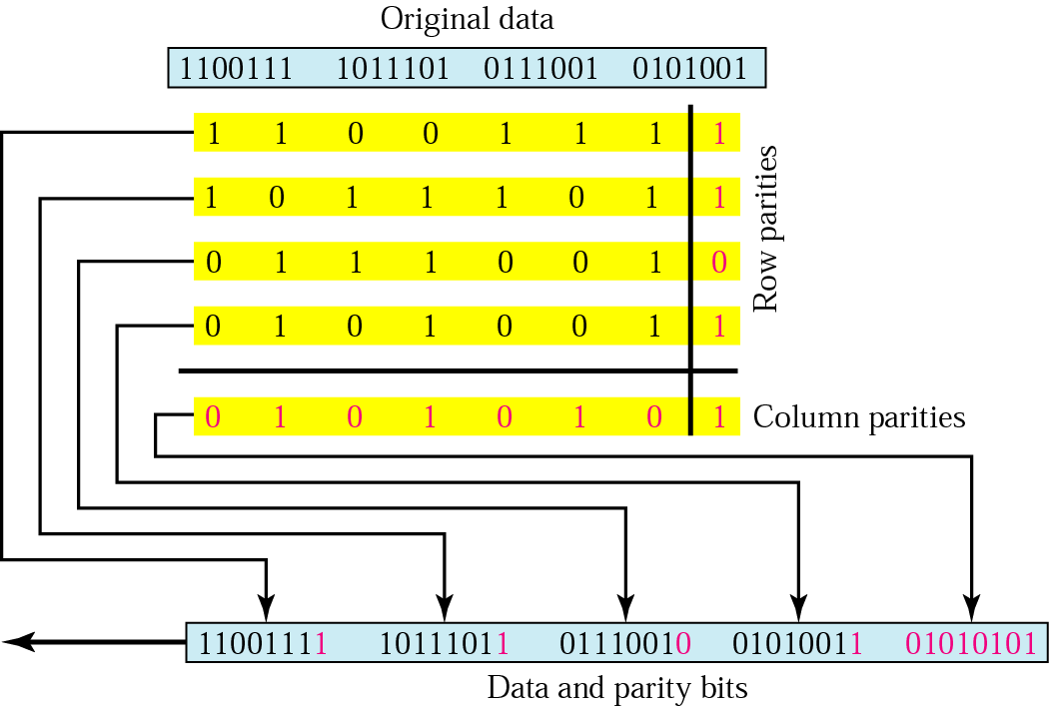

Slide 19
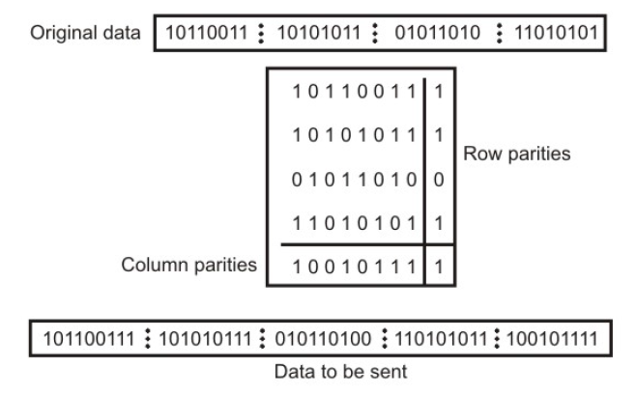
Two-dimension Parity Checking

Slide 20
(2) Checksum
The sender follows these steps:
The unit is divided into k sections, each of n bits.
All sections are added using one’s complement to get the sum.
The sum is complemented and becomes the checksum.
The checksum is sent with the data.
The receiver follows these steps:
The unit is divided into k sections, each of n bits.
All sections are added using one’s complement to get the sum.
The sum is complemented.
If the result is zero, the data are accepted: otherwise, rejected.

Slide 21
Example Part 1
Suppose the following block of 16 bits is to be sent using a checksum of 8 bits.
10101001 00111001
The numbers are added using one’s complement
10101001
00111001 ------------ Sum 11100010
Checksum 00011101
The pattern sent is 10101001 00111001 00011101

Slide 22
Example part 2
Now suppose the receiver receives the pattern sent in Example 7 and there is no error.
10101001 00111001 00011101
When the receiver adds the three sections, it will get all 1s, which, after complementing, is all 0s and shows that there is no error.
10101001
00111001
00011101
Sum 11111111
Complement 00000000 means that the pattern is OK.

Slide 23
Cyclic Redundancy Checks (CRC)
This is the most powerful and easy to implement technique.
Unlike checksum scheme, which is based on addition, CRC is based on binary division.
In CRC, a sequence of redundant bits, called cyclic redundancy check bits, are appended to the end of data unit so that the resulting data unit becomes exactly divisible by a second, predetermined binary number.
At the destination, the incoming data unit is divided by the same number.
If at this step there is no remainder, the data unit is assumed to be correct and is therefore accepted.
A remainder indicates that the data unit has been damaged in transit and therefore must be rejected

Slide 24
Cyclic Redundancy Check
Given a k-bit frame or message, the transmitter generates an n-bit sequence, known as a frame check sequence (FCS), so that the resulting frame, consisting of (k+n) bits, is exactly divisible by some predetermined number.
The receiver then divides the incoming frame by the same number and, if there is no remainder, assumes that there was no error.

Slide 25
Cyclic Redundancy Check (CRC)

Slide 26
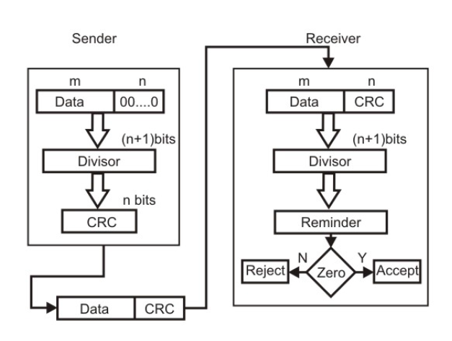
Basic scheme for Cyclic Redundancy Checking

Slide 27
In mathematical operation dividing a sample 4-bit number by 1011, using the modulo-2 arithmetic.
Modulo-2 arithmetic is a binary addition process without any carry over, which is just the Exclusive-OR operation.
Consider the case where k=1101. Hence we have to divide 1101000 (i.e. k appended by 3 zeros) by 1011, which produces the remainder r=001, so that the bit frame (k+r) =1101001 is actually being transmitted through the communication channel.
At the receiving end, if the received number, i.e., 1101001 is divided by the same generator polynomial 1011 to get the remainder as 000, it can be assumed that the data is free of errors.

Slide 28
Binary Division

Slide 29
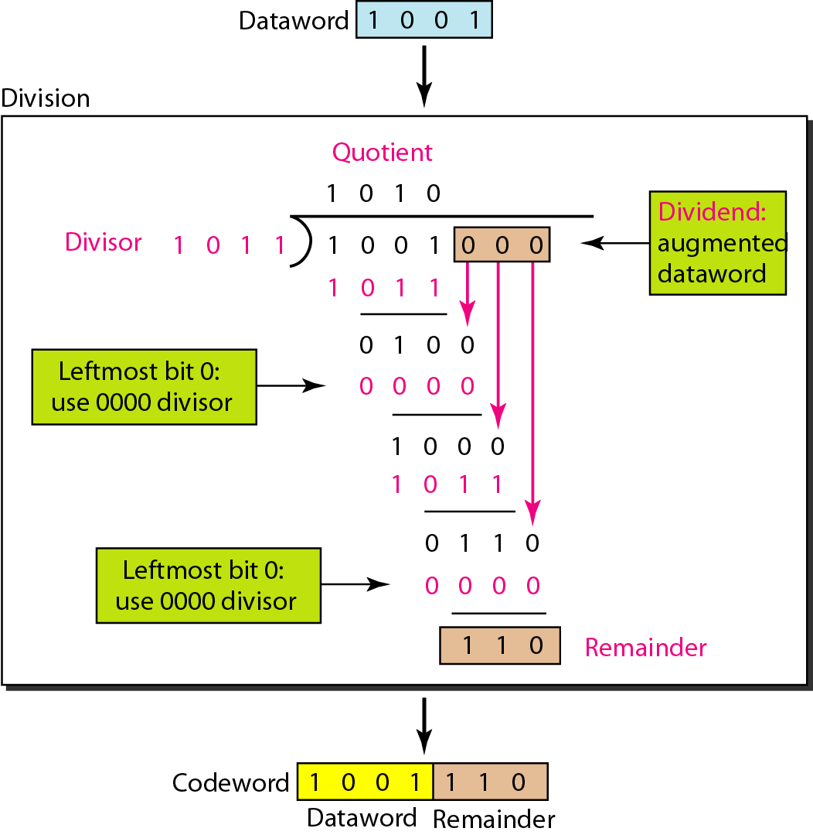
Division in CRC encoder

Slide 30
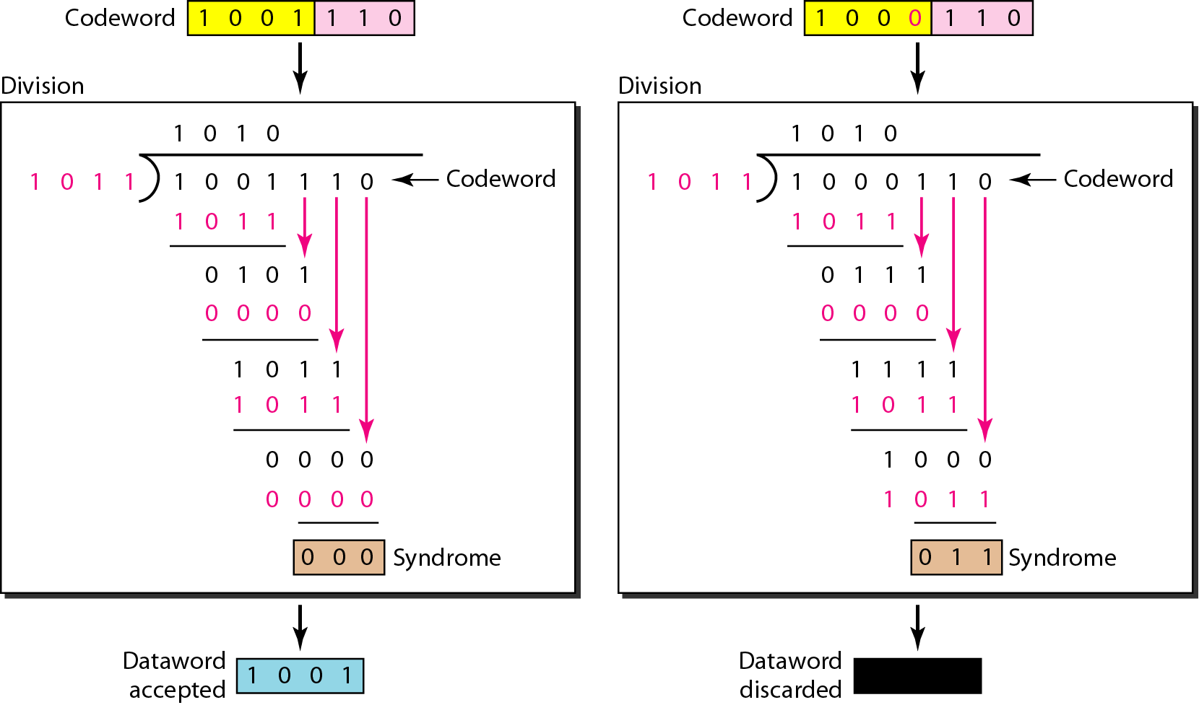
Division in the CRC decoder for two cases

Slide 31
Flow Control
Flow Control is a technique so that transmitter and receiver with different speed characteristics can communicate with each other.
Flow control ensures that a transmitting station, such as a server with higher processing capability, does not overwhelm a receiving station, such as a desktop system, with lesser processing capability.
This is where there is an orderly flow of transmitted data between the source and the destination.

Slide 32
is a set of procedures that tells the sender how much data it can transmit before it must wait for an acknowledgment from the receiver.
The flow of data should not be allowed to overwhelm the receiver.
Receiver should also be able to inform the transmitter before its limits (this limit may be amount of memory used to store the incoming data or the processing power at the receiver end) are reached and the sender must send fewer frames.
Hence, Flow control refers to the set of procedures used to restrict the amount of data the transmitter can send before waiting for acknowledgment.

Slide 33
Flow Control
Flow control coordinates the amount of data that can be sent before receiving acknowledgement
It is one of the most important functions of data link layer.
Flow control is a set of procedures that tells the sender how much data it can transmit before it must wait for an acknowledgement from the receiver.
Receiver has a limited speed at which it can process incoming data and a limited amount of memory in which to store incoming data.
Receiver must inform the sender before the limits are reached and request that the transmitter to send fewer frames or stop temporarily.
Since the rate of processing is often slower than the rate of transmission, receiver has a block of memory (buffer) for storing incoming data until they are processed.

Slide 34
Flow control techniques
1. Stop-and-wait
Stop-and-wait is also known as Request/reply sometimes.
Request/reply (Stop-and-wait) flow control requires each data packet to be acknowledged by the remote host before the next packet is sent.
2. Sliding-window.
Sliding window algorithms, used by TCP, permit multiple data packets to be in simultaneous transit, making more efficient use of network bandwidth .

Slide 36
Stop and Wait
Source transmits frame
Destination receives frame and replies with acknowledgement
Source waits for ACK before sending next frame
Destination can stop flow by not send ACK
Major drawback :
only one frame can be in transmission at a time, this leads to inefficiency if propagation delay is much longer than the transmission delay.

Slide 37
Stop and Wait

Slide 38
Link Utilization in Stop-and-Wait
Transmission time: The time it takes for a station to transmit a frame (normalized to a value of 1).
Propagation delay: The time it takes for a bit to travel from sender to receiver (expressed as a).
a < 1 :The frame is sufficiently long such that the first bits of the frame arrive at the destination before the source has completed transmission of the frame.
a > 1: Sender completes transmission of the entire frame before the leading bits of the frame arrive at the receiver.
The link utilization U = 1/(1+2a),
a = Propagation time / transmission time

Slide 39
link utilization(cont……..)
link utilization is strongly dependent on the ratio of the propagation time to the transmission time.
When the propagation time is small, as in case of LAN environment, the link utilization is good.
But, in case of long propagation delays, as in case of satellite communication, the utilization can be very poor.
To improve the link utilization, we can use the sliding-window protocol instead of using stop-and-wait protocol.

Slide 40
Sliding Window
With the use of multiple frames for a single message, the stop-and-wait protocol does not perform well.
Only one frame at a time can be in transit.
In stop-and-wait flow control, if a > 1, serious inefficiencies result.
Efficiency can be greatly improved by allowing multiple frames to be in transit at the same time.
Efficiency can also be improved by making use of the full-duplex line.

Slide 41
Sliding Window(sender)
To keep track of the frames, sender station sends sequentially numbered frames.
Since the sequence number to be used occupies a field in the frame, it should be of limited size.
If the header of the frame allows k bits, the sequence numbers range from 0 to 2^{k} – 1.
Sender maintains a list of sequence numbers that it is allowed to send (sender window).
The size of the sender’s window is at most 2^{k} – 1.
The sender is provided with a buffer equal to the window size.

Slide 42
Sliding Window(Receiver)
The receiver acknowledges a frame by sending an ACK frame that includes the sequence number of the next frame expected.
This also explicitly announces that it is prepared to receive the next N frames, beginning with the number specified.
This scheme can be used to acknowledge multiple frames. It could receive frames 2, 3, 4 but withhold ACK until frame 4 has arrived.
By returning an ACK with sequence number 5, it acknowledges frames 2, 3, 4 in one go.
The receiver needs a buffer of size 1.

Slide 43
Sender Sliding Window

Slide 44
Receiver Sliding Window

Slide 45
Sliding Window Example

Slide 46
Sender

Slide 47
Receiver

Slide 48
link utilization in Sliding Window
U = 1, for N > 2a + 1
N /(1+2a), for N < 2a + 1
Where N = the window size,
and a = Propagation time / transmission time
EX. K=5 then N=2^5-1=31
a=10 then U=1 &
When a=100 then U=31/(1+200)

Slide 49
Error Control Techniques
When an error is detected in a message, the receiver sends a request to the transmitter to retransmit the ill-fated message or packet.
The most popular retransmission scheme is known as Automatic-Repeat-Request (ARQ).
Such schemes, where receiver asks transmitter to re-transmit if it detects an error, are known as reverse error correction techniques.

Slide 50
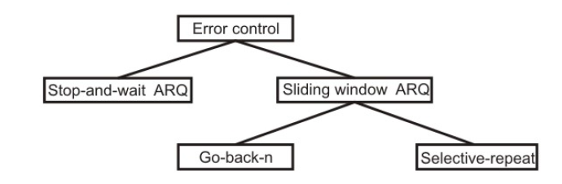
Error control techniques

Slide 51
Error Control Mechanisms
Stop-and-Wait
Go-Back-N ARQ
Selective-Repeat ARQ

Slide 52
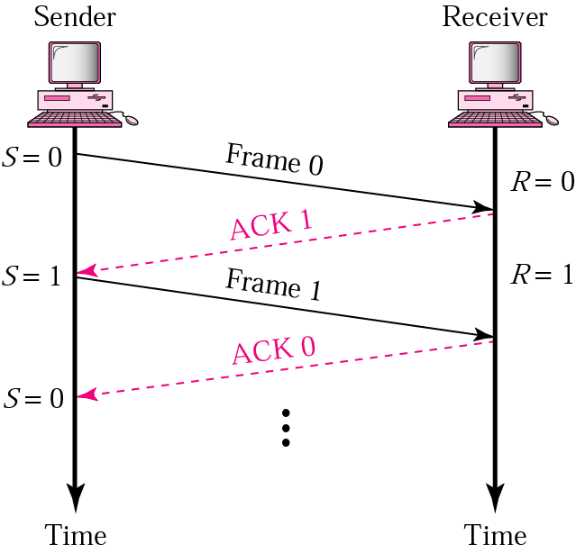
Stop-and-Wait
Sender keeps a copy of the last frame until it receives an acknowledgement.
For identification, both data frames and acknowledgements (ACK) frames are numbered alternatively 0 and 1.
Sender has a control variable (S) that holds the number of the recently sent frame. (0 or 1)
Receiver has a control variable that holds the number of the next frame expected (0 or 1).
Sender starts a timer when it sends a frame. If an ACK is not received within a allocated time period, the sender assumes that the frame was lost or damaged and resends it
Receiver send only positive ACK if the frame is intact.
ACK number always defines the number of the next expected frame

Slide 53
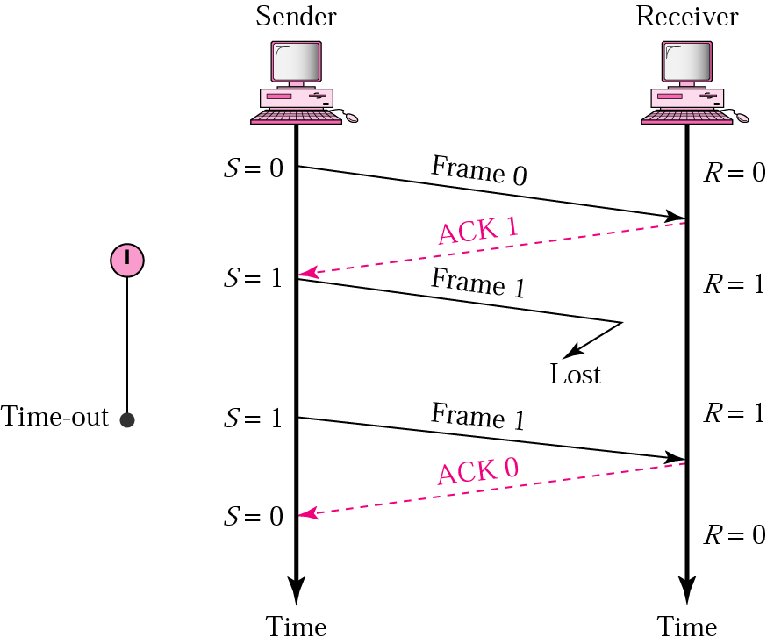
Stop-and-Wait ARQ, lost frame
When a receiver receives a damaged frame, it discards it and keeps its value of R.
After the timer at the sender expires, another copy of frame 1 is sent.

Slide 54
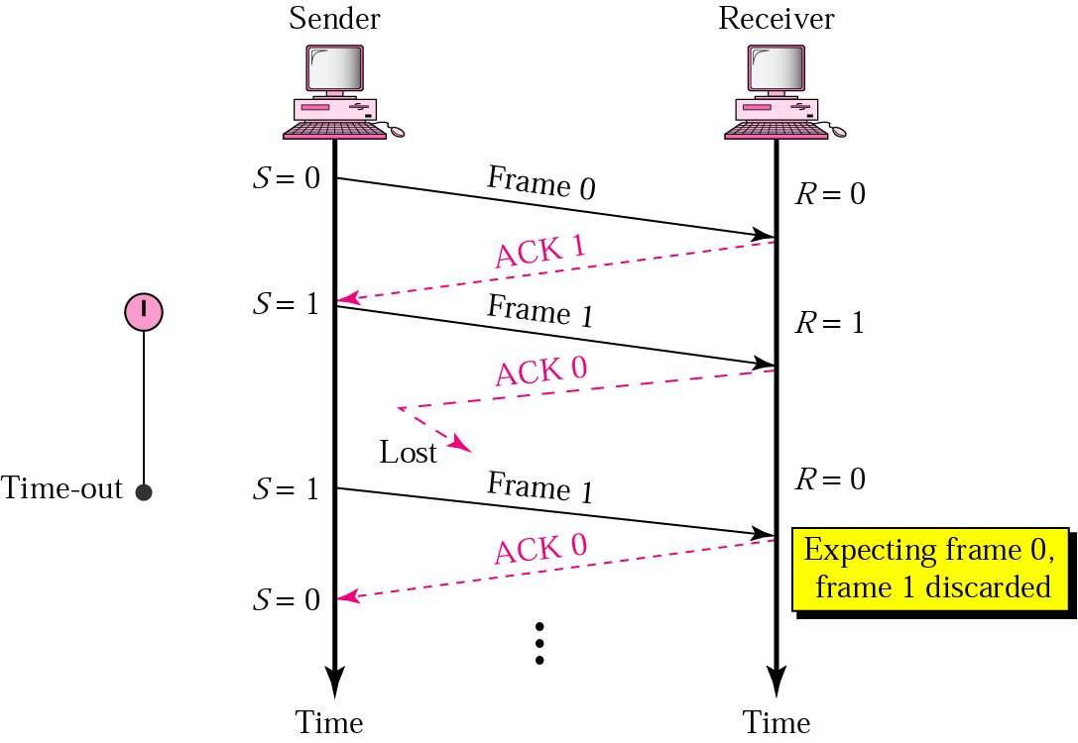
Stop-and-Wait, lost ACK frame
If the sender receives a damaged ACK, it discards it.
When the timer of the sender expires, the sender retransmits frame 1.
Receiver has already received frame 1 and expecting to receive frame 0 (R=0). Therefore it discards the second copy of frame 1.

Slide 55
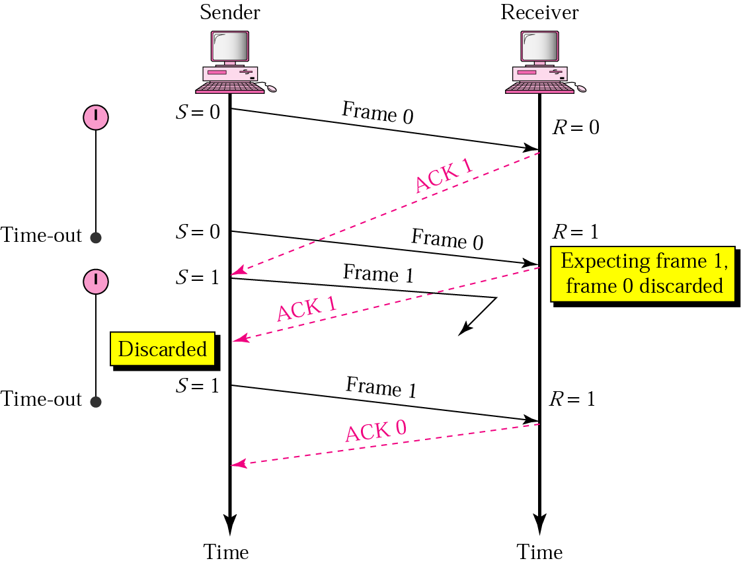
Stop-and-Wait, delayed ACK frame
The ACK can be delayed at the receiver or due to some problem
It is received after the timer for frame 0 has expired.
Sender retransmitted a copy of frame 0. However, R =1 means receiver expects to see frame 1. Receiver discards the duplicate frame 0.
Sender receives 2 ACKs, it discards the second ACK.

Slide 56
Disadvantage of Stop-and-Wait
In stop-and-wait, at any point in time, there is only one frame that is sent and waiting to be acknowledged.
This is not a good use of transmission medium.
To improve efficiency, multiple frames should be in transition while waiting for ACK.
Two protocol use the above concept,
Go-Back-N ARQ
Selective Repeat ARQ

Slide 57
Go-Back-N ARQ
We can send up to W frames before worrying about ACKs.
We keep a copy of these frames until the ACKs arrive.
This procedure requires additional features to be added to Stop-and-Wait ARQ.

Slide 58
Sequence Numbers
Frames from a sender are numbered sequentially.
We need to set a limit since we need to include the sequence number of each frame in the header.
If the header of the frame allows m bits for sequence number, the sequence numbers range from 0 to 2 ^{m} – 1. for m = 3, sequence numbers are: 0,1, 2, 3, 4, 5, 6, 7.
We can repeat the sequence number.
Sequence numbers are:
0, 1, 2, 3, 4, 5, 6, 7, 0, 1, 2, 3, 4, 5, 6, 7, 0, 1, …

Slide 59
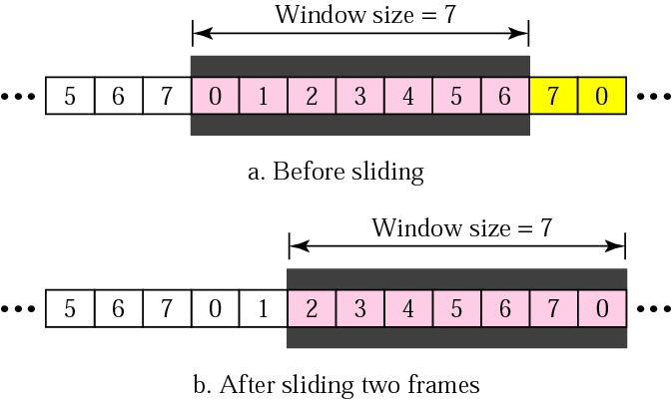
Sender Sliding Window
At the sending site, to hold the outstanding frames until they are acknowledged, we use the concept of a window.
The size of the window is at most 2^{m} -1 where m is the number of bits for the sequence number.
Size of the window can be variable, e.g. TCP.
The window slides to include new unsent frames when the correct ACKs are received

Slide 60
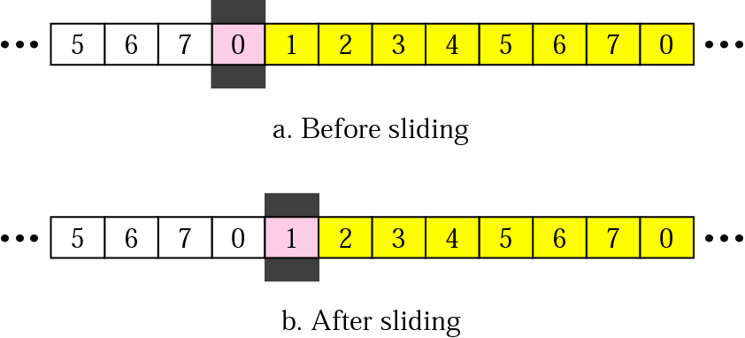
Receiver Sliding Window
Size of the window at the receiving site is always 1 in this protocol.
Receiver is always looking for a specific frame to arrive in a specific order.
Any frame arriving out of order is discarded and needs to be resent.
Receiver window slides as shown in fig. Receiver is waiting for frame 0 in part a.

Slide 61
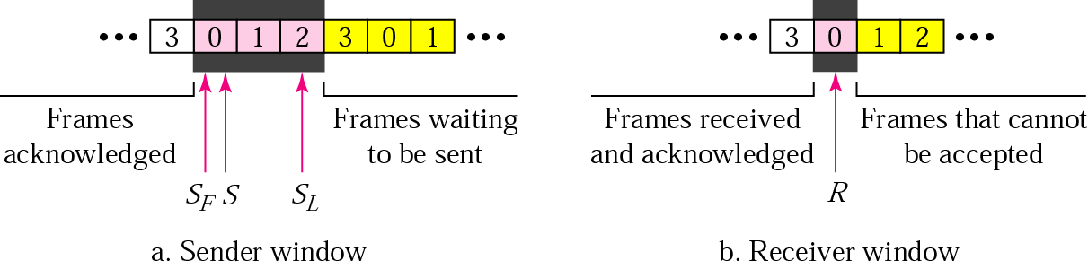
Control Variables
Sender has 3 variables: S, S_{F}, and S_{L}
S holds the sequence number of recently sent frame
S_{F} holds the sequence number of the first frame
S_{L} holds the sequence number of the last frame
Receiver only has the one variable, R, that holds the sequence number of the frame it expects to receive. If the seq. no. is the same as the value of R, the frame is accepted, otherwise rejected.

Slide 62
Acknowledgement
Receiver sends positive ACK if a frame arrived safe and in order.
If the frames are damaged/out of order, receiver is silent and discard all subsequent frames until it receives the one it is expecting.
The silence of the receiver causes the timer of the unacknowledged frame to expire.
Then the sender resends all frames, beginning with the one with the expired timer.
For example, suppose the sender has sent frame 6, but the timer for frame 3 expires (i.e. frame 3 has not been acknowledged), then the sender goes back and sends frames 3, 4, 5, 6 again. Thus it is called Go-Back-N-ARQ
The receiver does not have to acknowledge each frame received, it can send one cumulative ACK for several frames.

Slide 63
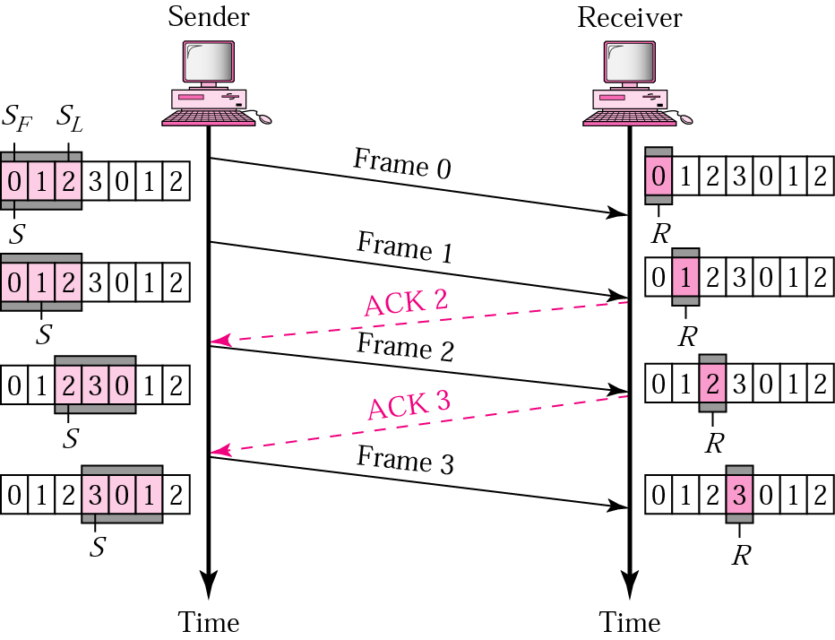
Go-Back-N ARQ, normal operation
The sender keeps track of the outstanding frames and updates the variables and windows as the ACKs arrive.

Slide 64
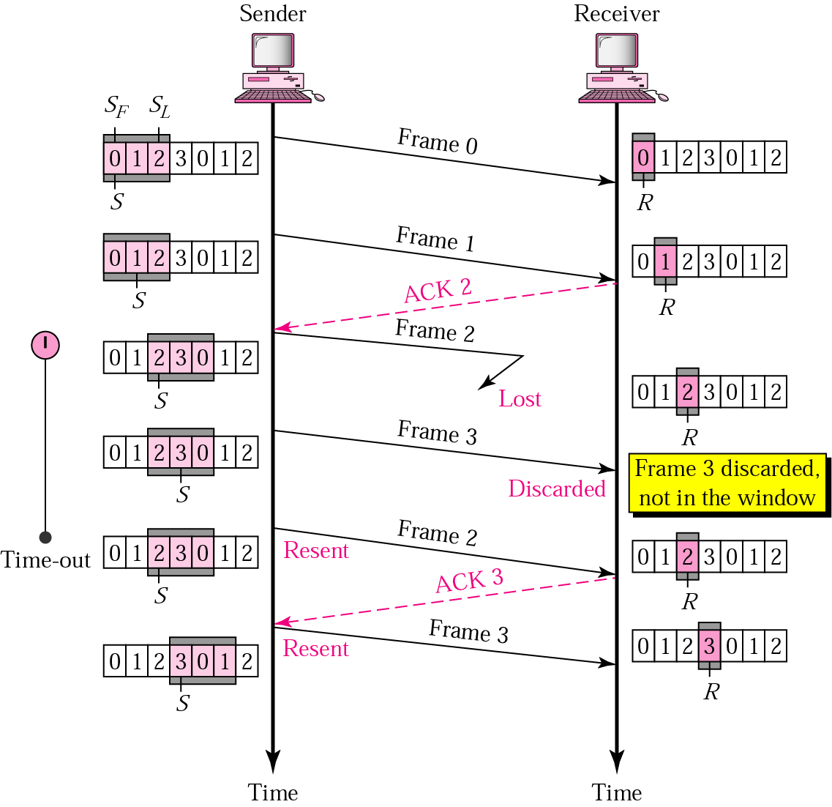
Go-Back-N ARQ, damaged or lost frame
Frame 2 is lost
When the receiver receives frame 3, it discards frame 3 as it is expecting frame 2 (according to window).
After the timer for frame 2 expires at the sender site, the sender sends frame 2 and 3. (go back to 2)

Slide 65
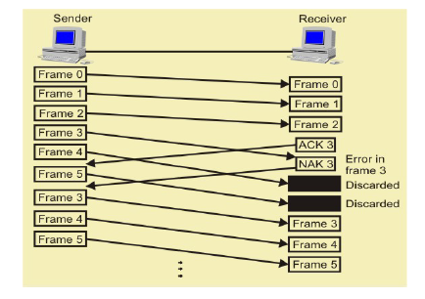
Frames in error in go-Back-N ARQ

Slide 66
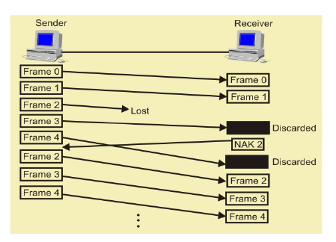
Lost Frames in Go-Back-N ARQ

Slide 67
Go-Back-N ARQ, damaged/lost/delayed ACK
If an ACK is damaged/lost, we can have two situations:
If the next ACK arrives before the expiration of any timer, there is no need for retransmission of frames because ACKs are cumulative in this protocol.
If ACK1, ACK2, and ACk3 are lost, ACK4 covers them if it arrives before the timer expires.
If ACK4 arrives after time-out, the last frame and all the frames after that are resent.
Receiver never resends an ACK.
A delayed ACK also triggers the resending of frames

Slide 68
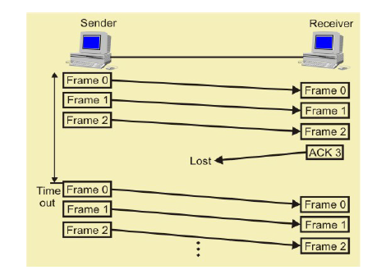
Lost ACK in Go-Back-N ARQ

Slide 69
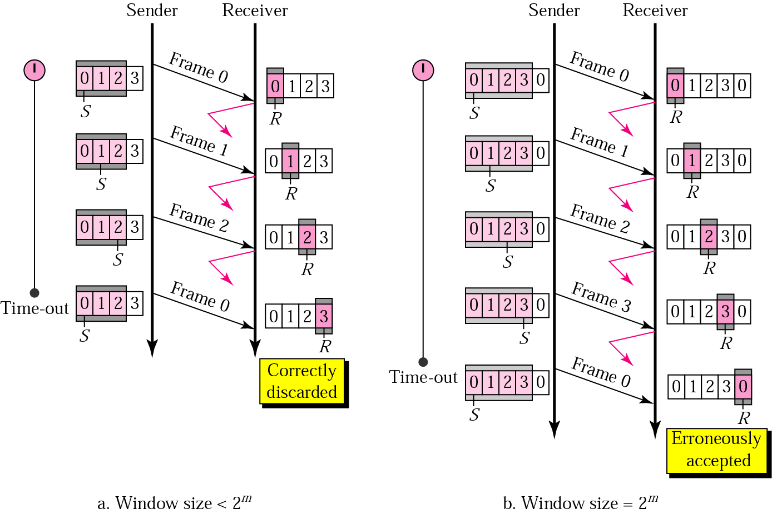
Go-Back-N ARQ, sender window size
Size of the sender window must be less than 2 ^{m}. Size of the receiver is always 1. If m = 2, window size = 2 ^{m} – 1 = 3.
Fig compares a window size of 3 and 4.
Accepts as the 1st frame in the next cycle-an error

Slide 70
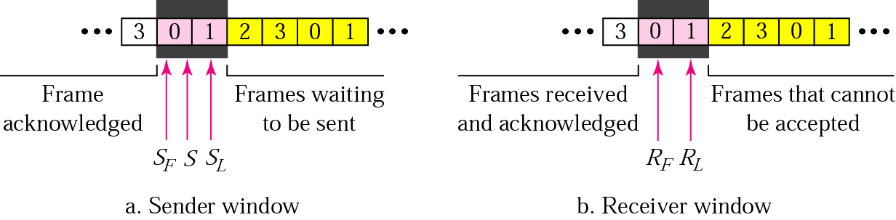
Selective Repeat ARQ, sender and receiver windows
Go-Back-N ARQ simplifies the process at the receiver site. Receiver only keeps track of only one variable, and there is no need to buffer out-of-order frames, they are simply discarded.
However, Go-Back-N ARQ protocol is inefficient for noisy link. It bandwidth inefficient and slows down the transmission.
In Selective Repeat ARQ, only the damaged frame is resent. More bandwidth efficient but more complex processing at receiver.
It defines a negative ACK (NAK) to report the sequence number of a damaged frame before the timer expires.

Slide 71
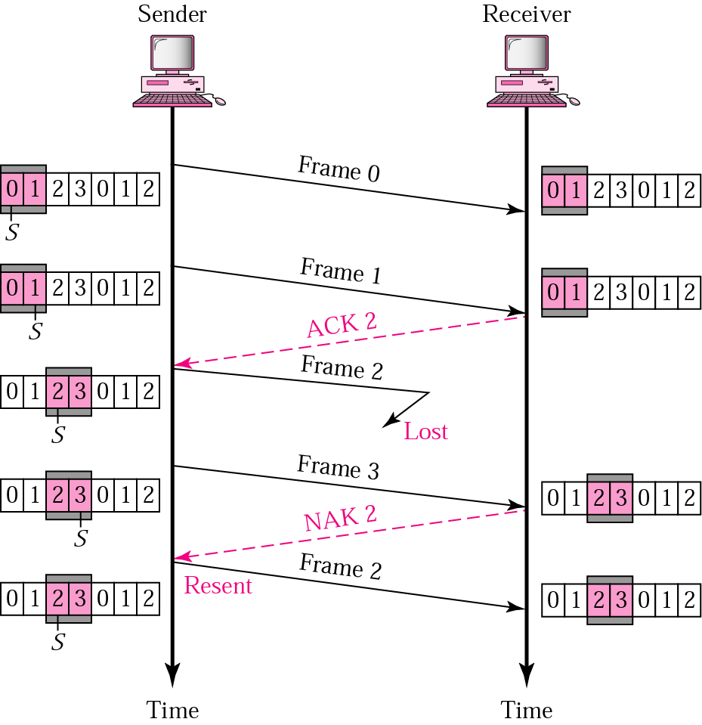
Selective Repeat ARQ, lost frame
Frames 0 and 1 are accepted when received because they are in the range specified by the receiver window. Same for frame 3.
Receiver sends a NAK2 to show that frame 2 has not been received and then sender resends only frame 2 and it is accepted as it is in the range of the window.

Slide 72
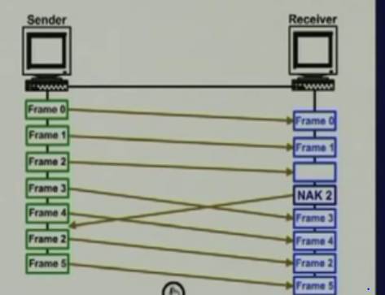
Selective Repeat ARQ

Slide 73
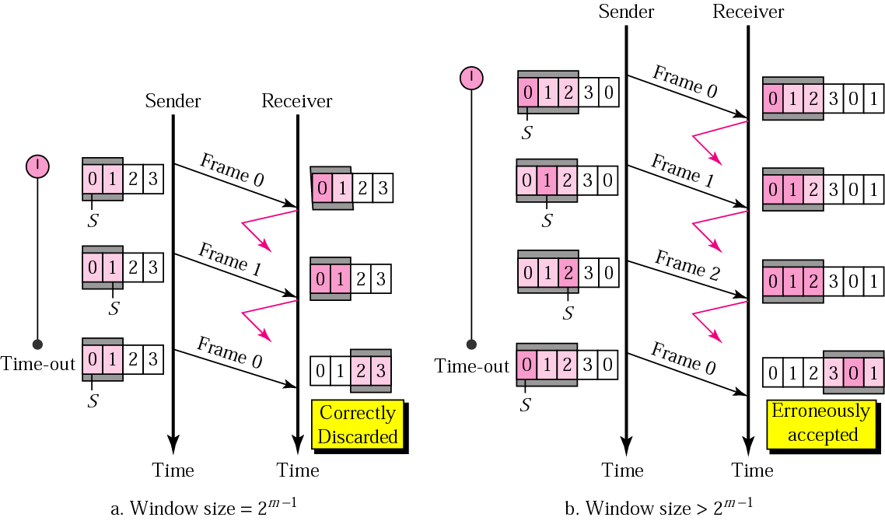
Selective Repeat ARQ, sender window size
Size of the sender and receiver windows must be at most one-half of 2 ^{m}. If m = 2, window size should be 2 ^{m} /2 = 2. Fig compares a window size of 2 with a window size of 3. Window size is 3 and all ACKs are lost, sender sends duplicate of frame 0, window of the receiver expect to receive frame 0 (part of the window), so accepts frame 0, as the 1st frame of the next cycle – an error.

Slide 74
Institute of Electrical and Electronics Engineers (IEEE) 802 Standards
IEEE 802.1: Standards related to network management.
IEEE 802.2: General standard for the data link layer in the OSI Reference Model. The IEEE divides this layer into two sublayers -- the logical link control (LLC) layer and the media access control (MAC) layer.
IEEE 802.3: Defines the MAC layer for bus networks that use CSMA/CD. This is the basis of the Ethernet standard.
IEEE 802.4: Defines the MAC layer for bus networks that use a token-passing mechanism (token bus networks).
IEEE 802.5: Defines the MAC layer for token-ring networks.
IEEE 802.6: Standard for Metropolitan Area Networks (MANs)
Notes:
IEEE is an organization composed of engineers, scientists, and students. The IEEE is best known for developing standards for the computer and electronics industry

Slide 75
LAN Protocol Architecture
Corresponds to lower two layers of OSI model
But mostly LANs do not follow OSI model
Current LANs are most likely to be based on Ethernet protocols developed by IEEE 802 committee
IEEE 802 reference model
Logical link control (LLC)
Media access control (MAC)
Physical

Slide 76
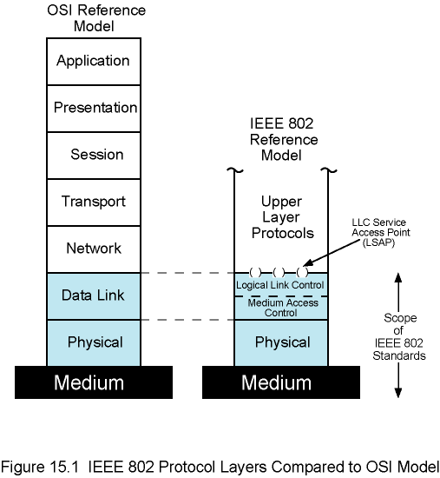
IEEE 802 Protocol Layers vs. OSI Model

Slide 77
IEEE 802 Layers - Physical
Signal encoding/decoding
Preamble generation/removal
for synchronization
Bit transmission/reception
Specification for topology and transmission medium

Slide 78
802 Layers - Medium Access Control & Logical Link Control
OSI layer 2 (Data Link) is divided into two in IEEE 802
Logical Link Control (LLC) layer
Medium Access Control (MAC) layer
LLC layer
Interface to higher levels
flow control
MAC layer
Prepare data for transmission
Error detection
Address recognition

Slide 79
Multiple Access
Problem: When two or more nodes transmit at the same time, their frames will collide and the link bandwidth is wasted during collision
How to coordinate the access of multiple sending/receiving nodes to the shared link???
Solution: We need a protocol to coordinate the transmission of the active nodes
These protocols are called Medium or Multiple Access Control (MAC) Protocols belong to a sub layer of the data link layer called MAC (Medium Access Control)

Slide 80
Multiple Access
What is expected from Multiple Access Protocols:
Main task is to minimize collisions in order to utilize the bandwidth by:
Determining when a station can use the link (medium)
what a station should do when the link is busy
what the station should do when it is involved in collision

Slide 81
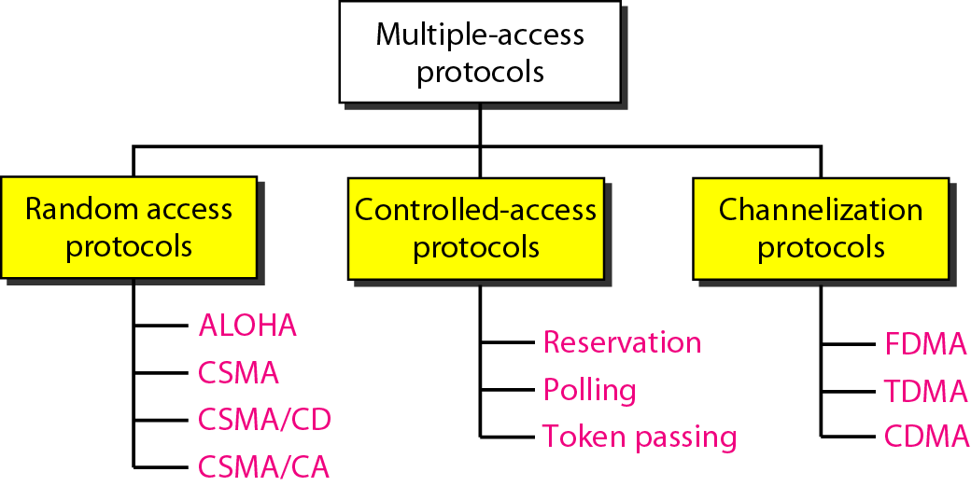
Figure . Taxonomy of multiple-access protocols

Slide 82
Random Access
Random Access (or contention) Protocols:
No station is superior to another station and none is assigned the control over another.
A station with a frame to be transmitted can use the link directly based on a procedure defined by the protocol to make a decision on whether or not to send.

Slide 83
CSMA (carrier sense multiple access)
To minimize the chance of collision and therefore increase the performance, the CSMA method was developed.
The chance of collision can be reduced if a station senses the medium before trying to use it.
CSMA requires that each station first listen to the medium (or check the state of the medium) before sending.
Principle: “sense before transmit” or “listen before talk”

Slide 84
CSMA…………
CSMA can reduce the possibility of collision, but it can’t eliminate it.
The possibility of collision still exists because of the propagation delay.
When a station sends a frame, it takes a while for the first bit to reach every station and for every station to sense it.
In other words, a station may sense the medium and find it idle, only because propagation by another station has not yet reached this station.

Slide 85
Carrier Sense Multiple Access Protocols
Protocols in which stations listen for a carrier (i.e., a transmission) and act accordingly are called carrier sense protocols.
Many stations can attempt to transmit at a time – multiple access.

Slide 86
PERSISTENT STRATEGY
It defines the procedures for a station that senses the busy medium
Two strategies:
1.nonpersistent,
2.persistent

Slide 87
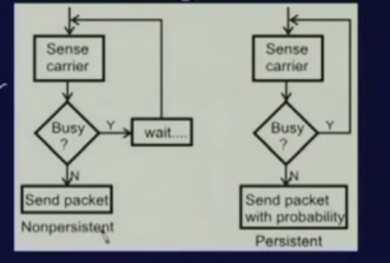
PERSISTENT STRATEGY

Slide 88
Non-persistent strategy
A station that has a frame to send senses the line.
If idle, sends immediately.
If not, the station waits for random period of time and then senses the line again.
Reduces chance of collision, two or more stations wait for same amount of time is unlikely.

Slide 89
Persistent strategy
A station senses the line.
If idle, sends the frame.
This method has two variations:
1.1-persistent,
2. p-persistent

Slide 90
CSMA types: nonpersistent
Nonpersistent:
Before sending, a station senses the channel. If no one else is sending, the station begins doing so itself.
However, if the channel is already in use, the station waits a random period of time and then repeats the algorithm.
Consequently, this algorithm leads to better channel utilization but longer delays than 1-persistent CSMA.

Slide 91
CSMA types:1-persistent
1-persistent: When a station has data to send, it first listens to the channel to see if anyone else is transmitting at that moment.
If the channel is busy, the station waits until it becomes idle. When the station detects an idle channel, it transmits a frame.
If a collision occurs, the station waits a random amount of time and starts all over again.
The protocol is called 1-persistent because the station transmits with a probability of 1 when it finds the channel idle.

Slide 92
CSMA types:p-persistent
p-persistent: It applies to slotted channels. When a station is to send, it senses the channel. If it is idle, it transmits with a probability p.
With a probability q = 1 - p, it defers until the next slot. If that slot is also idle, it either transmits or defers again, with probabilities p and q.
This process is repeated until either the frame has been transmitted or another station has begun transmitting.
In the latter case, the unlucky station acts as if there had been a collision (i.e., it waits a random time and starts again).
If the station initially senses the channel busy, it waits until the next slot and applies the above algorithm.

Slide 93
What is CSMA/CD?
CSMA/CD is a media access control mechanism used in Ethernet to recover from frame collision.
The following steps are used to recover from a collision.
Step 1: Before an Ethernet device sends a frame on the Ethernet cable, it listens to find if another device is already transmitting a frame (Carrier Sense).
Step 2: Once the device finds that other devices are not transmitting any frame, it starts transmitting the frame. If two devices detect that the Ethernet cable is free at the same time, then both will start transmitting the frames (Multiple Access). This will result in collision.

Slide 94
CSMA/CD……….
Step 3: The Ethernet devices while transmitting the frames, also listen for the collision. (Collision Detect). Step 4: If they detect a collision, both the devices stop sending the frame (back off). Step 5: They retry the transmission after a logarithmic time-out period. This process is repeated till the frame is transmitted successfully, for a maximum of 16 times. The frame is discarded after the 16th retry.

Slide 95
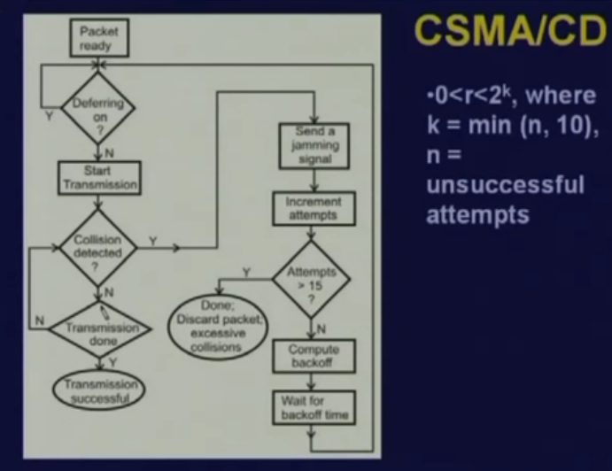

Slide 96
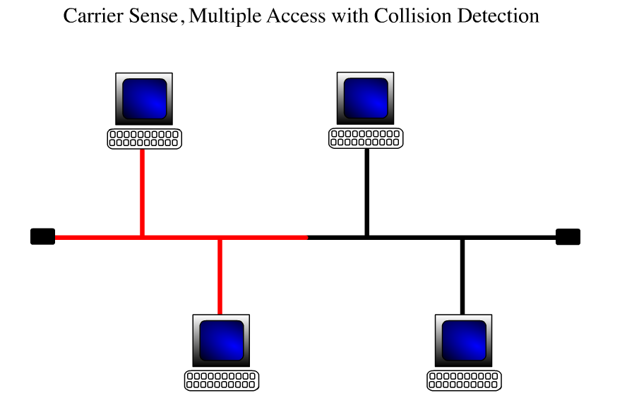

Slide 97
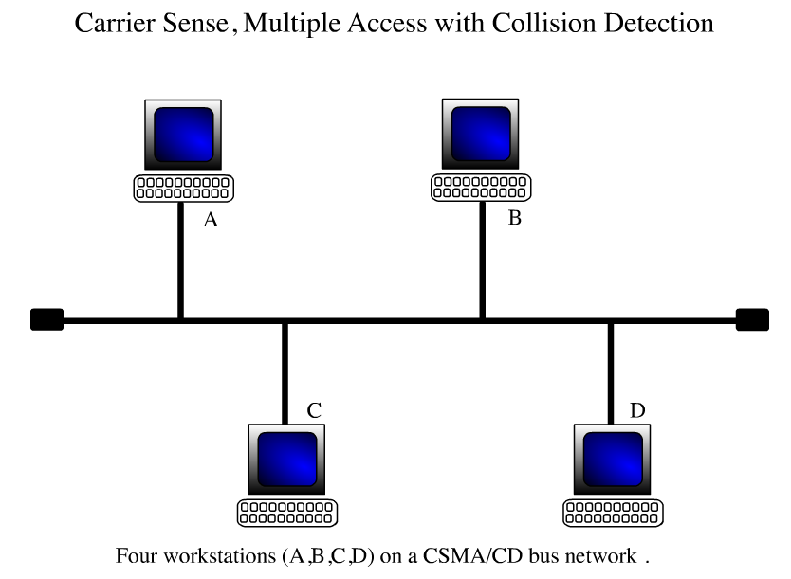

Slide 98
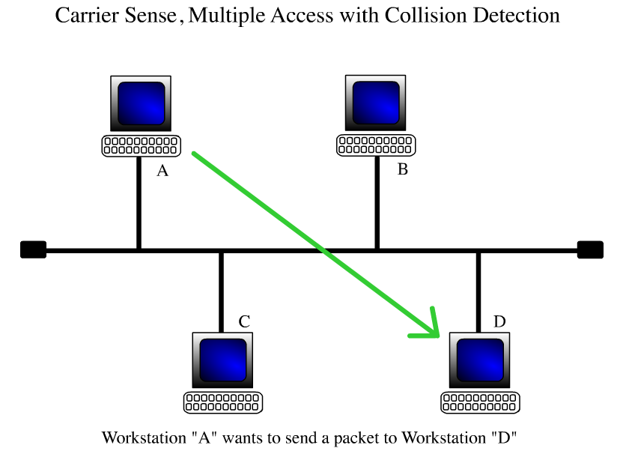

Slide 99
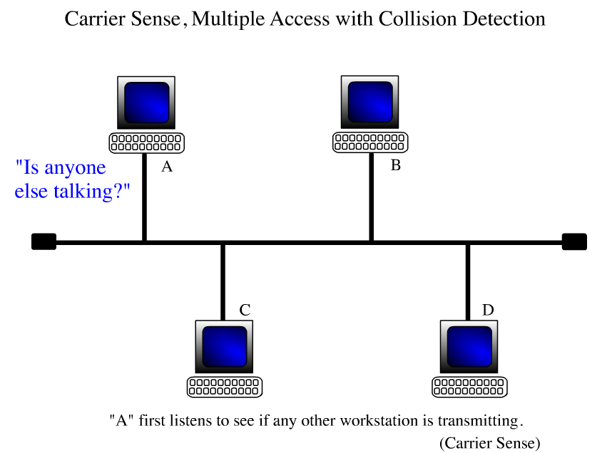

Slide 100
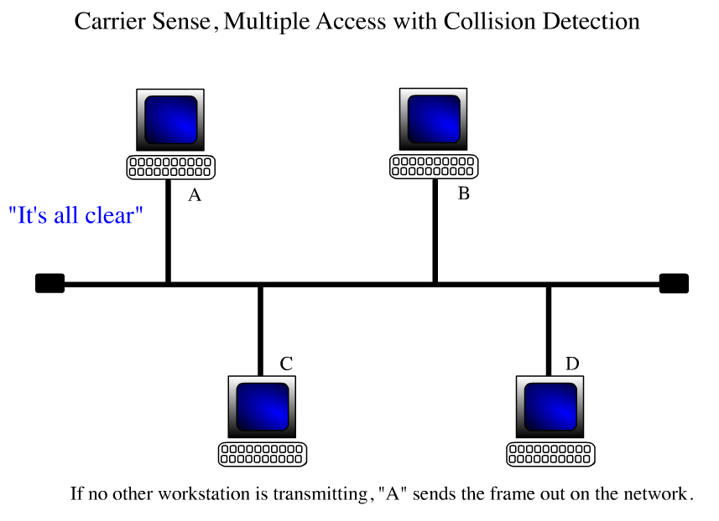

Slide 101
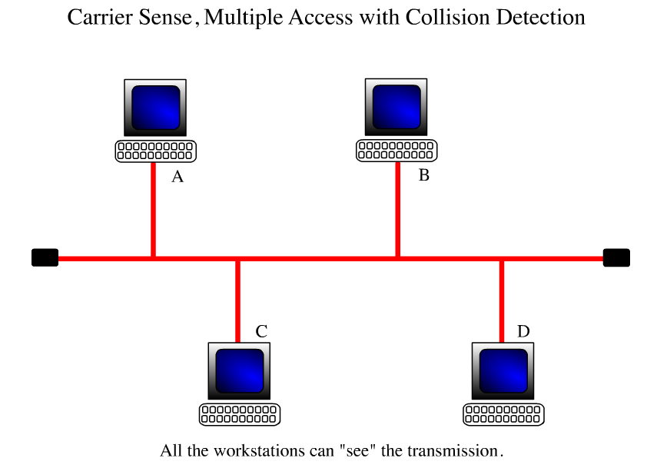

Slide 102
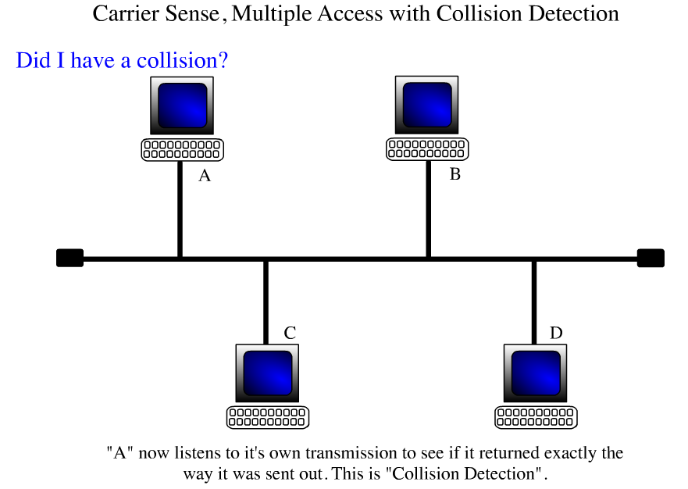

Slide 103
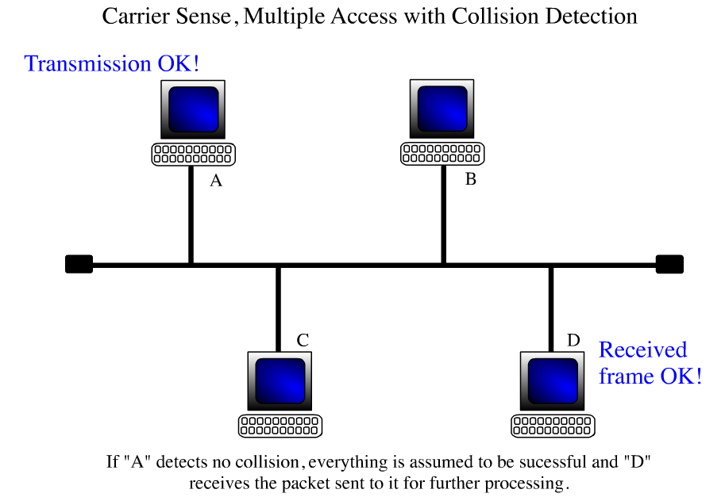

Slide 104
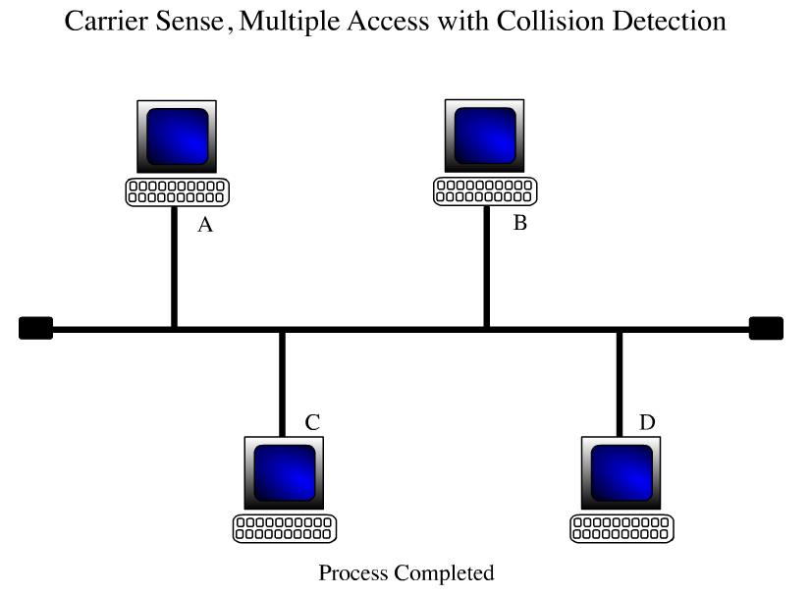

Slide 105
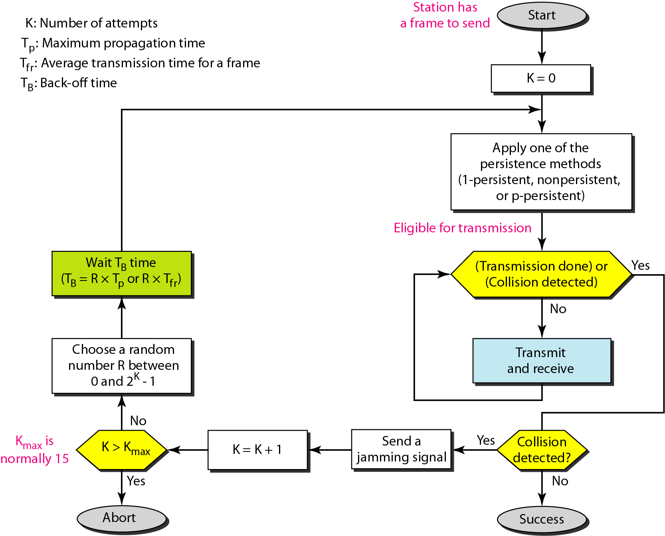
Flow diagram for the CSMA/CD

Slide 106
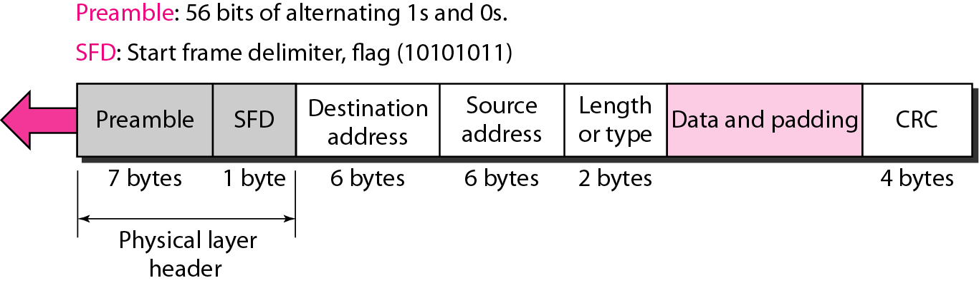
Figure: 802.3 MAC frame

Slide 107
Preamble: The first field of the 802.3 frame contains 7 bytes (56 bits) of alternating Os and Is that alerts the receiving system to the coming frame and enables it to synchronize its input timing.
Start frame delimiter (SFD). The second field (1 byte: 10101011) signals the beginning of the frame. The SFD warns the station or stations that this is the last chance for synchronization. The last 2 bits is 11 and alerts the receiver that the next field is the destination address.
Destination address (DA). The DA field is 6 bytes and contains the physical address of the destination station

Slide 108
Source address (SA). The SA field is also 6 bytes and contains the physical address of the sender of the packet
Length or type: The IEEE standard used it as the length field to define the number of bytes in the data field.
Data. This field carries data encapsulated from the upper-layer protocols. It is a minimum of 46 and a maximum of 1500 bytes
CRC. The last field contains error detection information, in this case a CRC-32

Slide 109
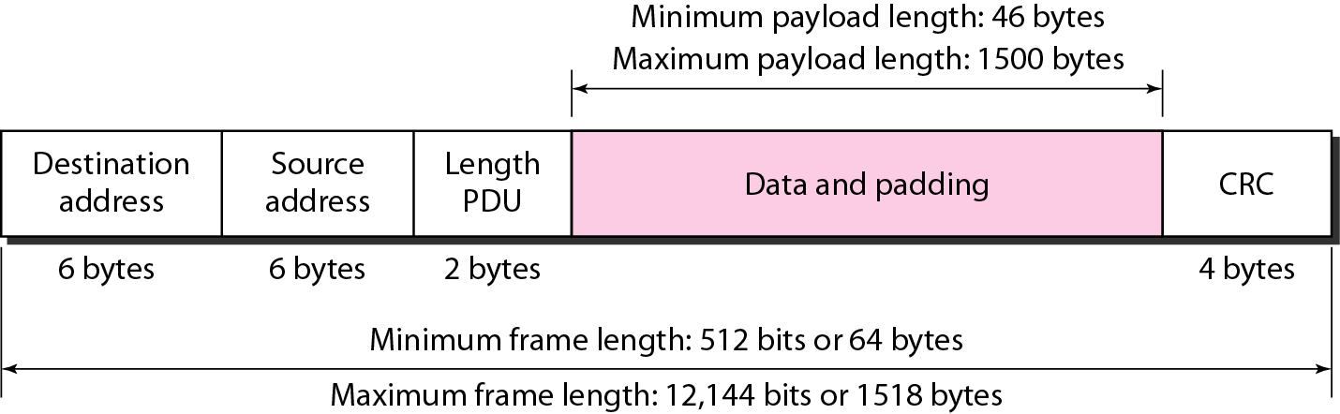
Figure : Minimum and maximum lengths

Slide 110
IEEE Standard 802.4: Token Bus
A linear or tree-shaped bus with N stations.
Stations are organized as a logical ring where each station knows the address of its logical right and left neighbors.
Only the station in possession of a special control packet “token” is allowed to transmit.
Once a station is done transmitting it passes the token to one of its two logical neighbors.
A station in possession of the token and data to transmit passes it on.
Collision-free protocol; no starvation.

Slide 111
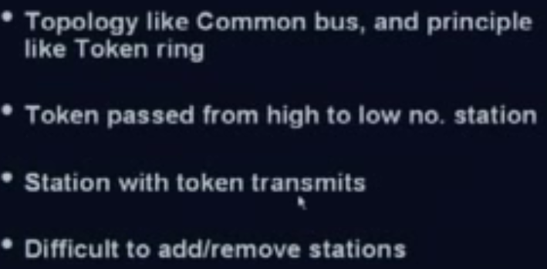
Token Bus

Slide 112
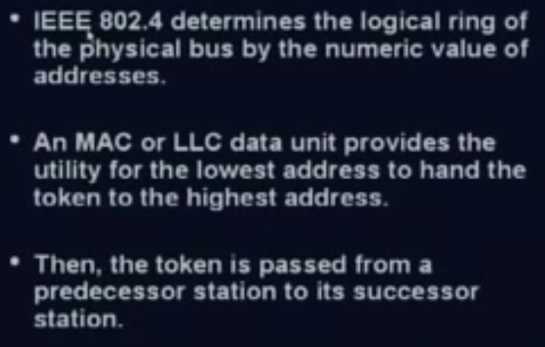
Token Bus

Slide 113
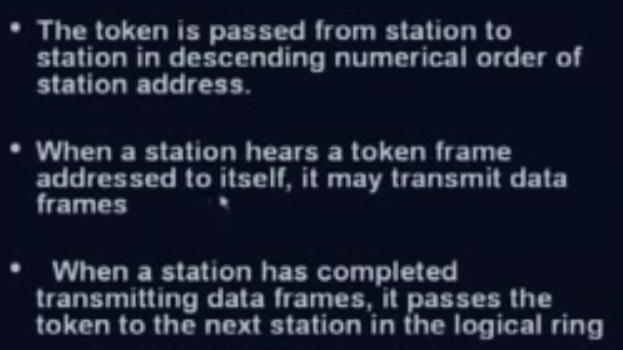
Token Bus

Slide 114
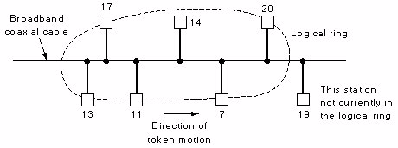
Token Bus………

Slide 115
Frame Format of Bus

Slide 116
The IEEE 802.4 is a popular standard for the bus based token passing LANs.
In a token bus LAN, the physical media is a bus and a logical ring as shown in the figure is created.
Physically, it is a Bus network. Logically, it is a Ring network Stations are organized as a circular doubly-linked list
The token is passed from one user to other in a sequence, decided in the logical ring.
The preamble is used to synchronize the receiver’s clock.
The start and end delimiter fields are used to mark the frame boundaries.

Slide 117
Token Bus…..
The frame control field is used to distinguish data frames from control frames.
For data frames, it carries the frame’s priority.
The token bus defines four priority classes-0, 2, 4 and 6 for traffic, with 0 the lowest and 6 the highest.
The data field may be up to 8182 bytes long when 2 bytes addresses are used and 8174 bytes when 6 bytes used.
The checksum is used to detect the errors in the frames.

Slide 118
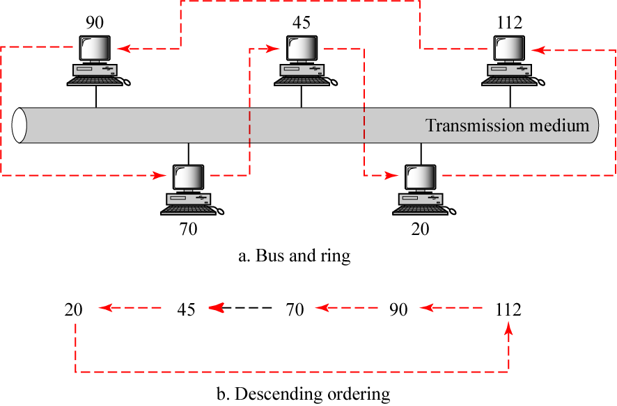
A Token Bus Network

Slide 119
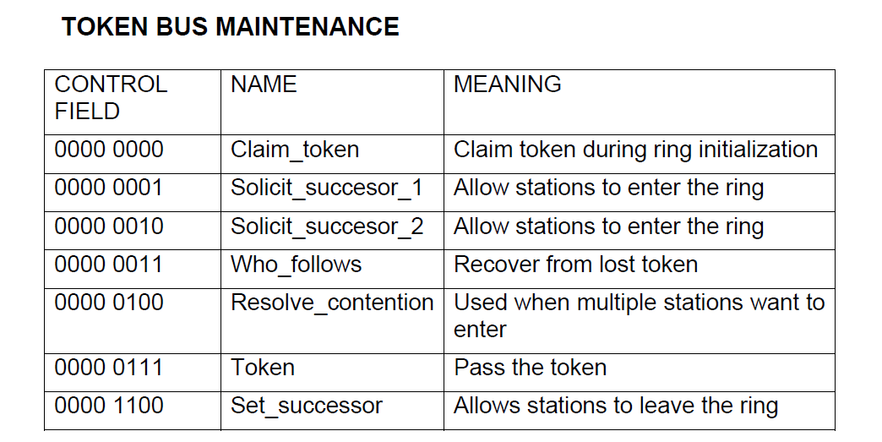
Token Bus control frames

Slide 120
Token Passing
In the token-passing method, the stations in a network are organized in a logical ring.
For each station, there is a predecessor and a successor.
The predecessor is the station which is logically before the station in the ring;
Successor is the station which is after the station in the ring.
The current station is the one that is accessing the channel now.
The right to this access has been passed from the predecessor to the current station.
The right will be passed to the successor when the current station has no more data to send.

Slide 121
In this method, a special packet called a token circulates through the ring Or in round robin manner.
The possession of the token gives the station the right to access the channel and send its data.
When a station has some data to send, it waits until it receives the token from its predecessor.
It then holds the token and sends its data. When the station has no more data to send, it releases the token, passing it to the next logical station in the ring.
The station cannot send data until it receives the token again in the next round.
In this process, when a station receives the token and has no data to send, it just passes the token to the next station.

Slide 122
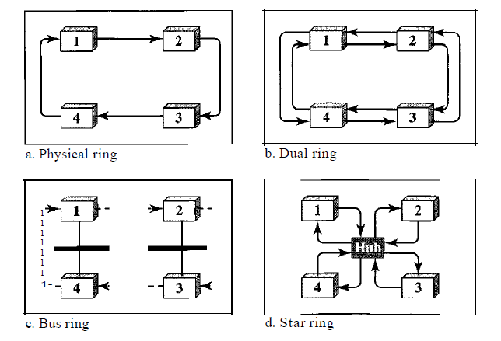
Logical ring and physical topology in token-passing access method

Slide 123
Token Passing

Slide 124
Token Passing

Slide 125
Token Passing

Slide 126
Token Passing

Slide 127
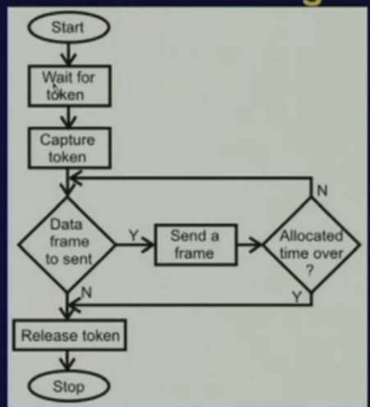

Slide 128
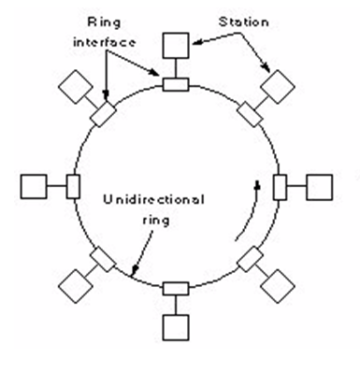
Token Ring

Slide 129



Slide 130



Slide 131


Slide 132



Slide 133
Token Ring Network with star topology

Slide 134
Wire Center
Ring has one difficulty in that all the stations have to be ON for passing the token.
Both physical and logical ring has this difficulty of modifying the ring when one or more stations go down.
The stations should inform about its going OFF.
So addressing is modified accordingly.
In token ring this problem is very elegantly handles using the wire center technique.
Here all the stations are connected to a wire center, where an automatic relay is placed across the lines joining a station.
As soon as the station is OFF, the relay is closed, so the ring formation is not broken.
Thus the token ring has physical star, logical ring topology

Slide 135

IEEE 802.5 token ring frame format

Slide 136
Frame format….
The starting and ending delimiter fields mark the beginning and ending of the frame.
Each contains invalid differential Manchester patterns to distinguish them from data bytes.
The access control byte contains the token bit(T), and also the monitoring bits(M), priority bits(P) and reservation bits(R).
The frame control byte, distinguishes data frames from various possible control frames.

Slide 137
P | P | P | T | M | R | R | R
Fig: Access Control field
A | C | X | X | A | C | X | X
Fig. Frame status field

Slide 138
Frame format…..
The frame status byte contains A(address recognized bits) and C(copied bits). When a frame arrives at the interface of a station with the destination address, the interface turns on the A bit as it passes through.
If the interface copies the frame to the station, it also turns on the C bit.
A station might fail to copy a frame due to lack of buffer space or other reasons.
Reserved bits(X)

Slide 139

frame status

Slide 140

Token Ring control frames

Slide 141

Fiber Distributed Data Interface(FDDI)

Slide 142

FDDI

Slide 143

FDDI Topology

Slide 144

FDDI Topology

Slide 145
FDDI Rings

Slide 146
FDDI Ring Failure

Slide 147

Counter – rotating ring

Slide 148

Ring operation

Slide 149

Ring operation

Slide 150

FDDI

Slide 151

Fault Tolerance

Slide 152

Fault Tolerance

Slide 153

Fault Tolerance

